Slide 1
Memory Experiment

Slide 2
Instructions
Take a blank piece of paper, Make space for writing down 5 lists of words
List 1
List 2
List 3
List 4
List 5

Slide 3
List 1
bed
rest
awake
tired
dream
wake
snooze
blanket
doze
slumber
snore
nap

Slide 4
30 second task
Count backwards from 217 by 3s for 30 seconds

Slide 5
Recall
Under List 1, write down as many words as you can remember from list 1
You have 1 minute

Slide 6
List 2
mad
fear
hate
rage
temper
fury
ire
wrath
happy
fight
hatred
mean

Slide 7
30 second task
Starting at 76, add 2, then subtract 3, then repeat.

Slide 8
Recall
Under List 2, write down as many words as you can remember from list 2
You have 1 minute

Slide 9
List 3
hot
snow
warm
winter
ice
wet
frigid
chilly
heat
weather
freeze
air

Slide 10
30 second task
say out loud, as many US states as you can in alphabetical order

Slide 11
Recall
Under List 3, write down as many words as you can remember from list 3
You have 1 minute

Slide 12
List 4
sour
candy
sugar
bitter
good
taste
tooth
nice
honey
soda
chocolate

Slide 13
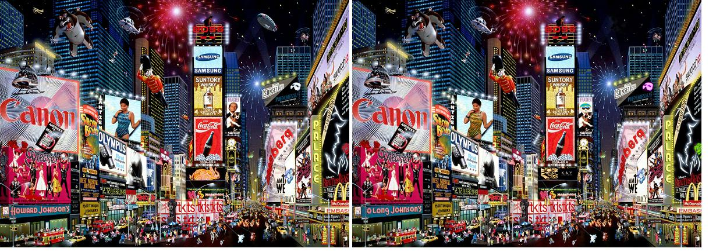
30 second task
Spot as many differences as you can

Slide 14
Recall
Under List 4, write down as many words as you can remember from list 4
You have 1 minute

Slide 15
List 5
apple
vegetable
orange
kiwi
citrus
ripe
pear
banana
berry
cherry
basket
juice

Slide 16
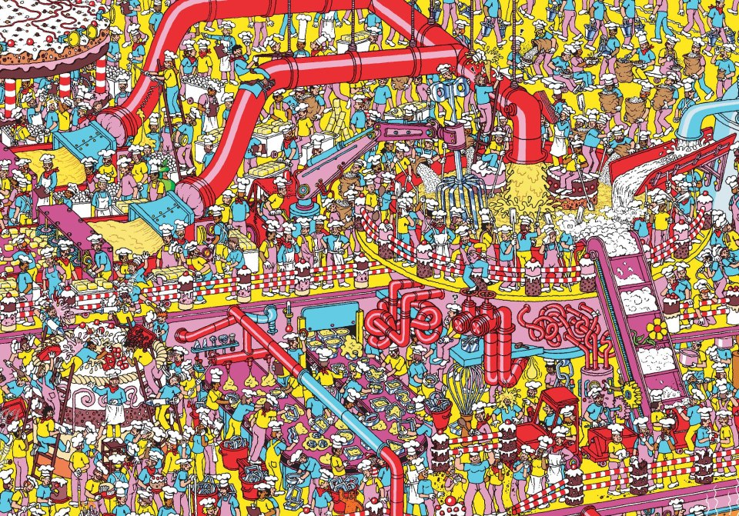
30 second task
Count the number of chef hats

Slide 17
Recall
Under List 5, write down as many words as you can remember from list 5
You have 1 minute

Slide 18
New piece of paper
Turn your recall lists over so you can’t see them
Take out a blank piece of paper

Slide 19
Recognition
Write down the numbers 1-20, like this:
1
2
3
4
Etc.,
For each word in the list, put O for OLD, and N for new.
Old = you remember the word from any of the previous lists
New=you do not remember this word from the previous lists

Slide 20
Recognition
hot
apple
hill
smooth
sweet
mountain
cold
table
anger
chair
river
bed
sour
water
sleep
door
mad
fruit
rough
window

Slide 21
False Memory

Slide 22
“Old” Items
bed
rest
awake
tired
dream
wake
snooze
blanket
doze
slumber
snore
nap
mad
fear
hate
rage
temper
fury
ire
wrath
happy
fight
hatred
mean
hot
snow
warm
winter
ice
wet
frigid
chilly
heat
weather
freeze
air
sour
candy
sugar
bitter
good
taste
tooth
nice
honey
soda
chocolate
apple
vegetable
orange
kiwi
citrus
ripe
pear
banana
berry
cherry
basket
juice
Let’s say, on average, participants just managed to recall 80% of the old items.
Can we say that we observed “false memory”?

Slide 23
“New” items
mad
fear
hate
rage
temper
fury
ire
wrath
happy
fight
hatred
mean
I.e., items that were actually not included in the list
Can we say we observed false memory, if someone put down “soya sauce”?

Slide 24
“Critical Lures”
mad
fear
hate
rage
temper
fury
ire
wrath
happy
fight
hatred
mean
We are not looking for random mistakes. Rather, we are looking for systematic mistakes
What kind of systematic mistakes?
Critical lures
  I.e., words that are not in the original list but people might think they are, because they are thematically related

Slide 25
Data
On a blank piece of paper write the following:
Recall
# of items falsely recalled _____________
Recognition
Old items, # said old___________
New items, # said old___________
Critical Lures, # said old__________

Slide 26
# of items falsely recalled _____________
For each list, add 1 if you wrote down the following words
List 1: Sleep
List 2: Anger
List 3: Cold
List 4: Sweet
List 5: Fruit
Write down the total, the lowest possible value is 0, and the highest is 5.

Slide 27
OLD, # you said Old______
hot
apple
hill
smooth
sweet
mountain
cold
table
anger
chair
river
bed
sour
water
sleep
door
mad
fruit
rough
window

Slide 28
New, # you said Old ______
hot
apple
hill
smooth
sweet
mountain
cold
table
anger
chair
river
bed
sour
water
sleep
door
mad
fruit
rough
window

Slide 29
Critical Lures, # you said Old______
hot
apple
hill
smooth
sweet
mountain
cold
table
anger
chair
river
bed
sour
water
sleep
door
mad
fruit
rough
window

Slide 30
Your Prediction

Slide 31
Your Prediction

